Slide 1
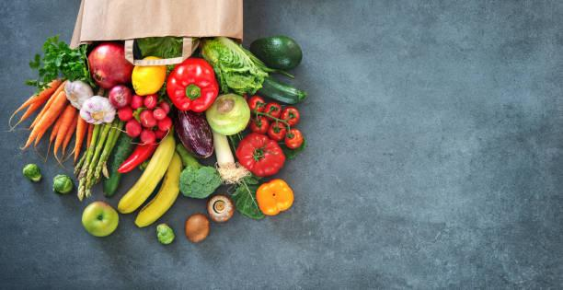
Project
on
supermarket
Billing
System
DONE BY:
PAVAN SAI
SAI KIRAN
DEVI SREE

Slide 2

CONTENT
TITLE
INTRODUCTION
MODULES
SCREENSHOTS
FUTURE SCOPE
CONCLUSION

Slide 3
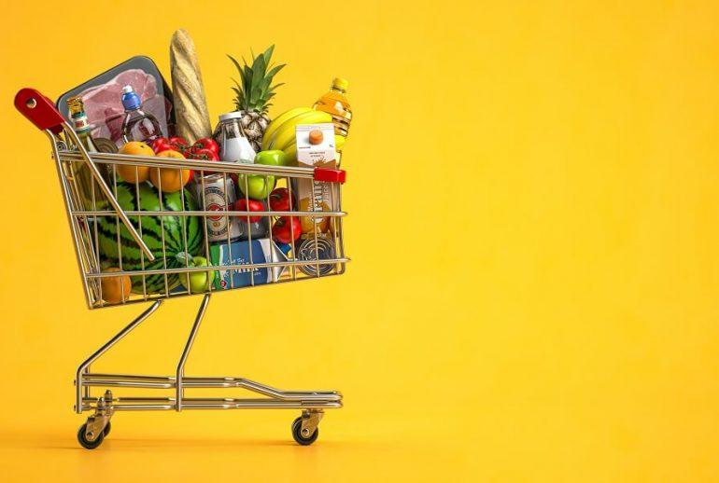
INTRODUCTION
A supermarket billing system is a computerized system used in supermarkets and other retail stores to manage and process customer transactions.
This system automates the entire billing process of sale to generating invoices and receipts for customers.

Slide 4

It is a single user interface .Totally done using the JFRAMES
Java Frames is a library used to create GUI(Graphical user interface
JFrame works like the main window where components like labels, buttons, textfields are added to create a GUI.
Storing the general information of customers and items, prices in the data base and getting those values using get method
It is basically a graphical user interface used for generating invoices and receipts for customers on their purchases in the super market

Slide 5
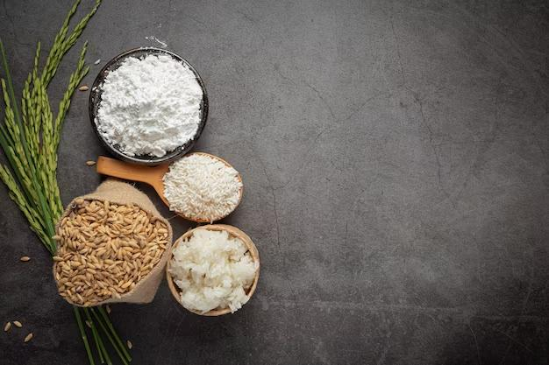
BENEFITS OF USING
BILLING SYSTEM
The benefits of using a supermarket billing system include increased efficiency, improved accuracy in pricing and inventory management, and the ability to generate detailed sales reports for analysis.
It also reduces the workload of the cashier and minimizes the risk of errors in billing and inventory management.

Slide 6
MODULES DESCRIPTION
LOGIN PAGE
REGISTER PAGE
HOME PAGE
BILLING PAGE
All above pages consists of entry fields and buttons in order to generate invoice and receipts for customers

Slide 7
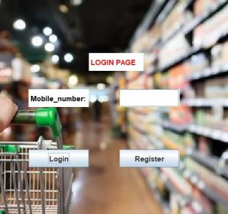
LOGIN PAGE
Login page consists of text field that user need to enter mobile no and two buttons Login and register
If you are new to this super market we need to register on click the Register button
If you are an existing customer you can login by using your mobile no

Slide 8
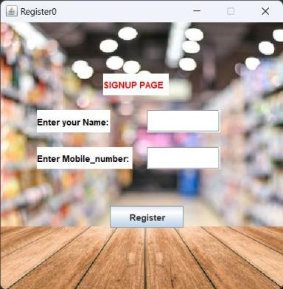
REGISTER PAGE
Register page contains two text fields and button that user need to enter mobile no and name and click on register button

Slide 9

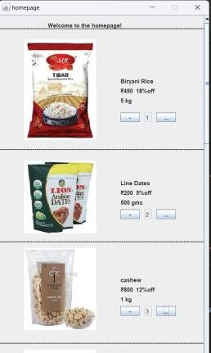
HOME PAGE
Home page consists of list of items that user need to select and one button to add items

Slide 10

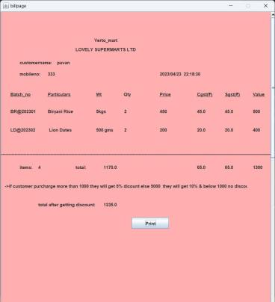
BILLING PAGE
Billing Page consists of General information of customer like Mobile No, Name of the customer and Items purchased by the Customer and its prices and Total Money of the items including GST

Slide 11

FUTURE SCOPE:
The supermarket billing system is built to help supermarkets calculate and display bills and serve the customer in a faster
and efficient manner

Slide 12

CONCLUSION:
We have successfully completed the project, and designed supermarket billing system. It is crucial for the efficient operation of modern retail stores. It improves accuracy, reduces manual errors.

Slide 13

Signing off
Pavan sai
Sai kiran
Devi sree

